Slide 1
Manhattan_Arrest_Analysis
File created on: 12/7/20 5:35:53 PM EST

Slide 2
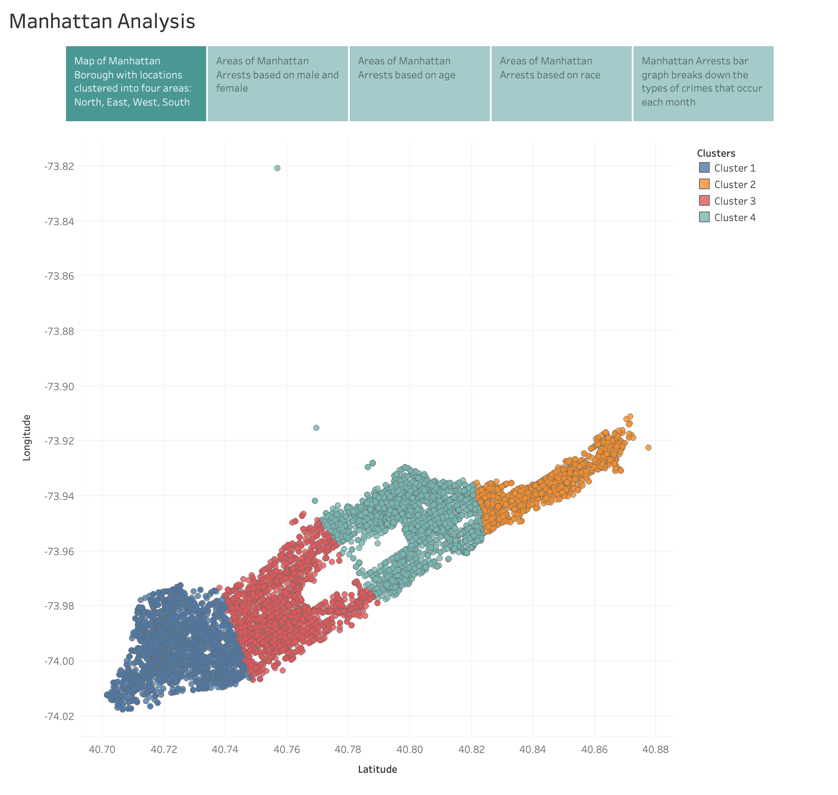

Slide 3
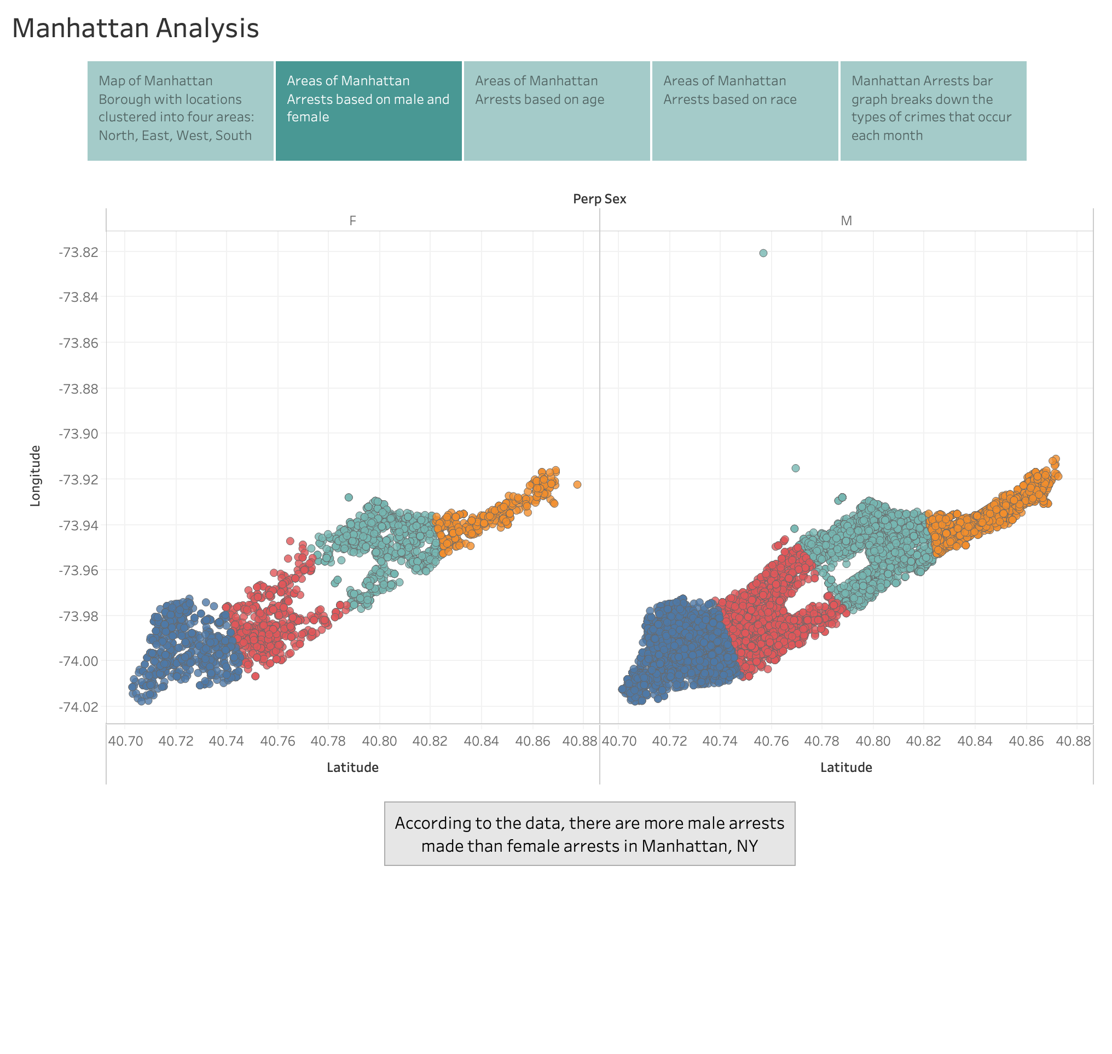

Slide 4
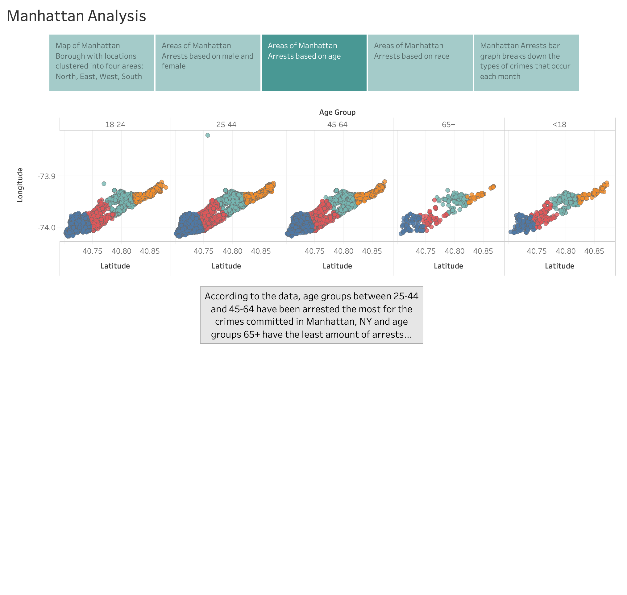

Slide 5
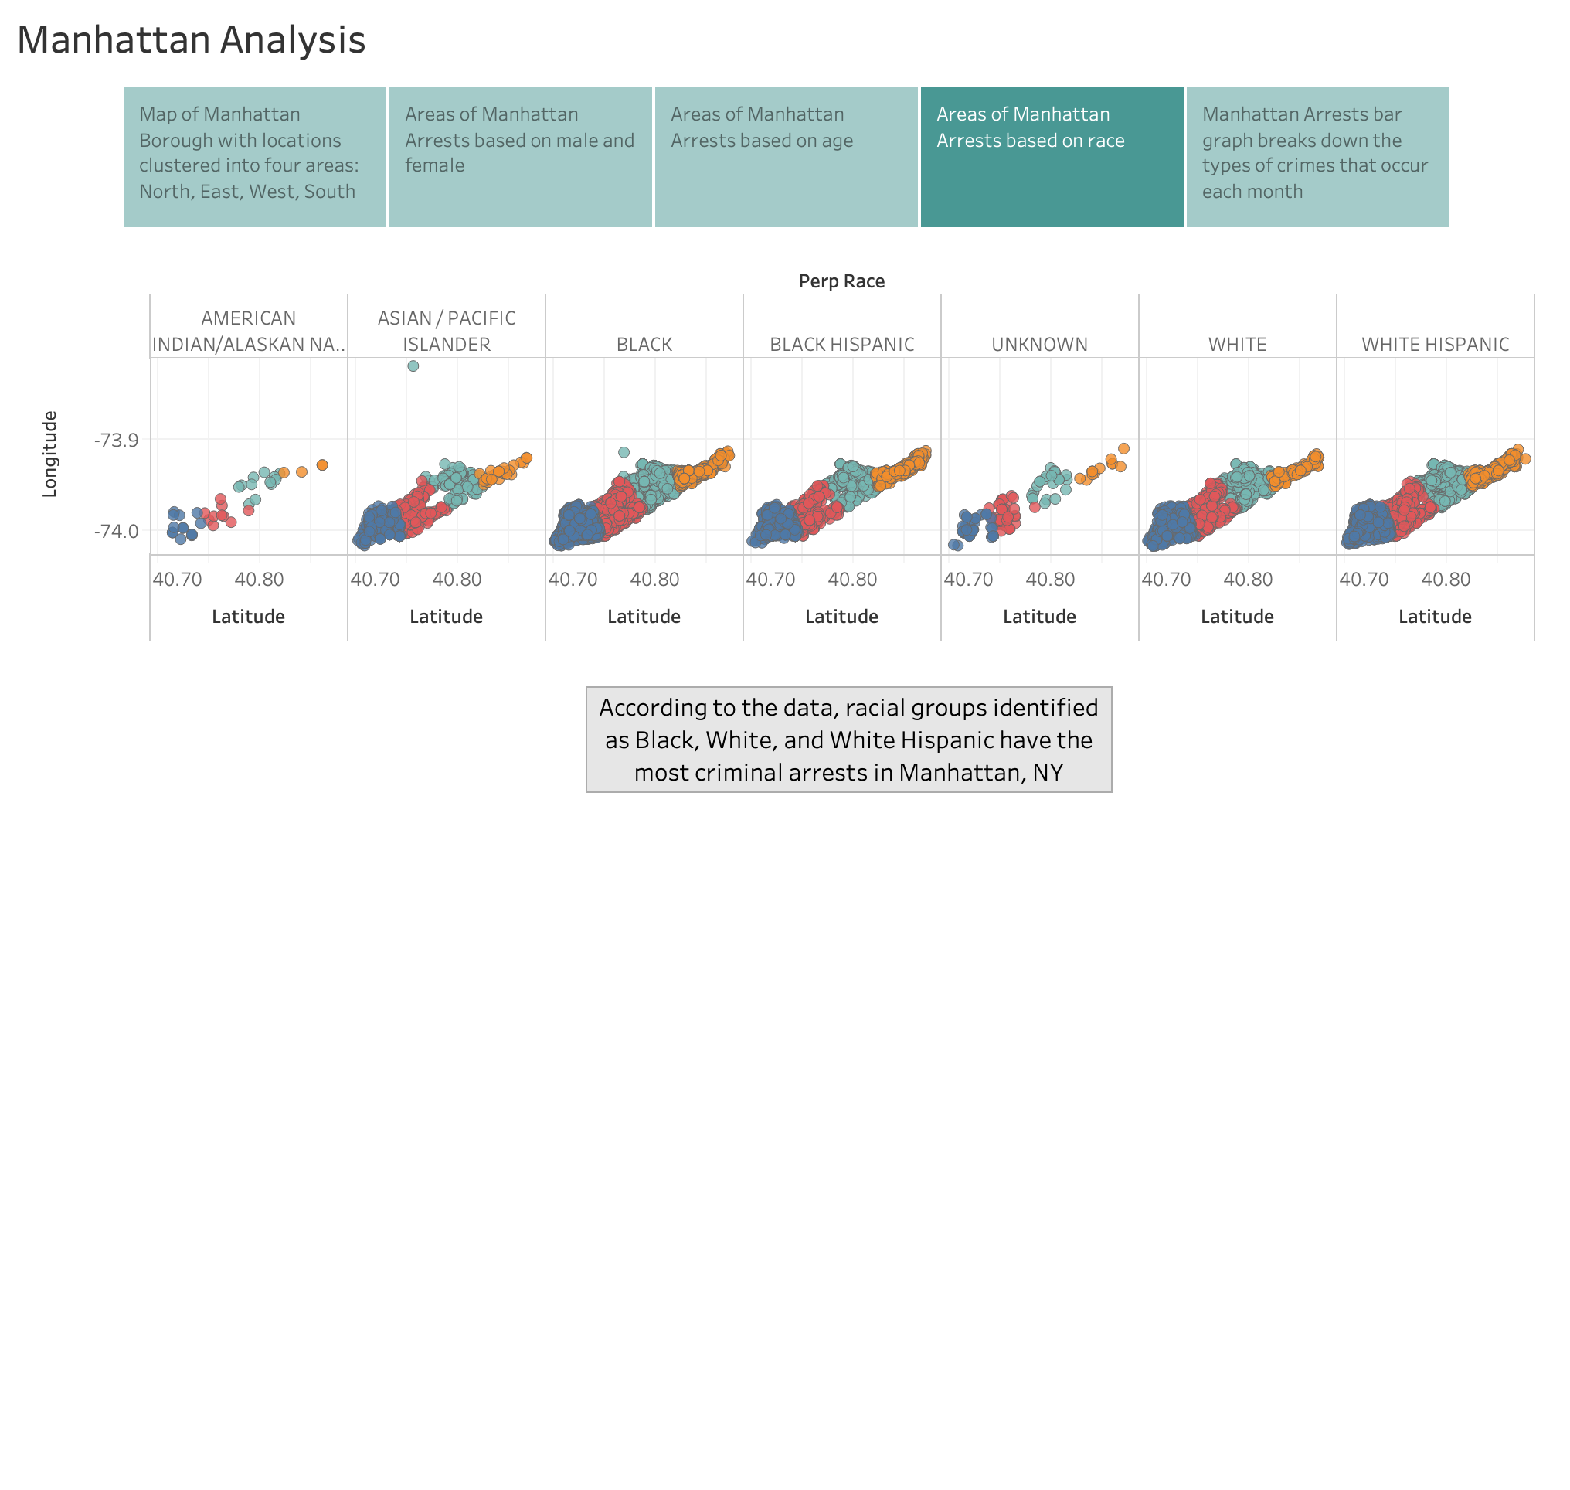

Slide 6
